Slide 1


ZOMBIATOR
Group 6
Preliminary Project Software 1
Group Members
1. Nhi Dinh
2. Lihini Hewage
3. Jiayue Zheng
4. Kamonnun Silarat

Slide 2


CONTENTS
1
IDEA AND GOAL OF THE GAME
2
DEMO OF THE GAME SHOW GAMEPLAY
3
DATABASE AND CODING SOLUTIONS
4
FURTHER DEVELOPMENT IDEAS

Slide 3
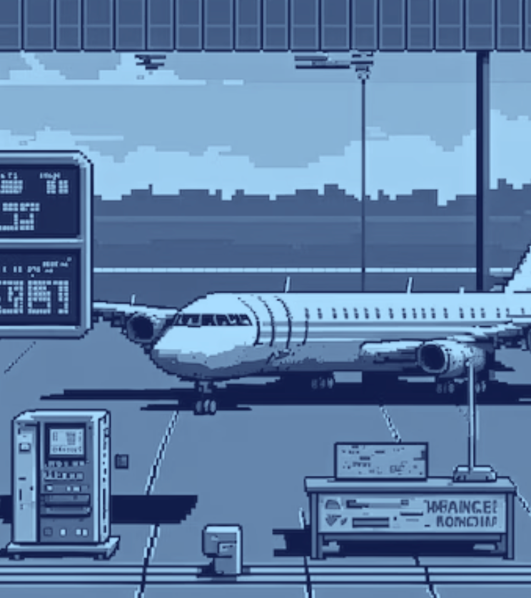



GAME IDEA
INVENTORY NEEDED:
MONEY
FUEL
WEAPONS
In 2025, Earth's environment is in crisis, causing a strange virus turned people into zombies. The player will play as a hero from Finland to rescue people in other trapped airports.
Rescue the World: Save survivors in different countries.
Manage Resources: Need money, fuel, and weapons to complete the mission
Face Challenges: Each city has a different missions with random difficulty levels.
Earn Rewards: Completing missions gives the player more money and weapons.
Unlock the Final Challenge: Collect enough weapons to go to Madrid. Completing the mission then gets huge rewards and becomes a hero.

Slide 4
ZOMBIATOR
True
Final mission completed
End
FLOWCHART
Mission Completed get reward
+ money
+ weapon
player_weapon >= final_weapon
True
False
+ weapon + money + fuel
-weapon
False
need_more money/weapon
False
Input command
player_fuel >= need_fuel
True
Arrive airport
Set up
Print
2
Check command
Enter
airport name
Input name
1
-money
-fuel
-weapon -airport lists
money(m) = 500 fuel(f) = 150 weapon(w) = 200 final_weapon = 2000 final_reward = 10000 location = “Finland”
3
player_weapon >= need_weapon
True
- money
+ fuel
Buy fuel
input amount
False
True
False
money >= money_spent
convert
fuel -> money
- weapon
Mission Failed
- 50% money
- 50% weapon location = “Finland”

Slide 5
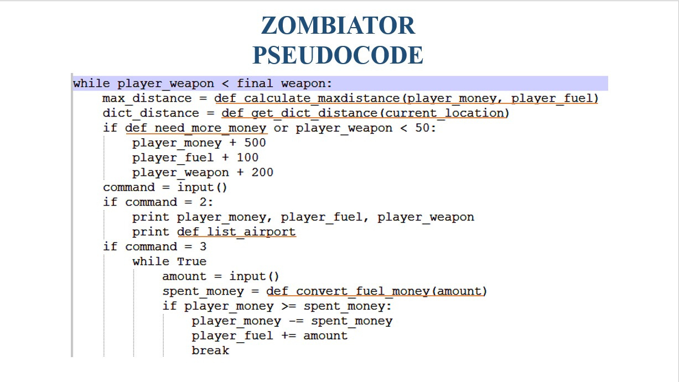
ZOMBIATOR PSEUDOCODE

Slide 6
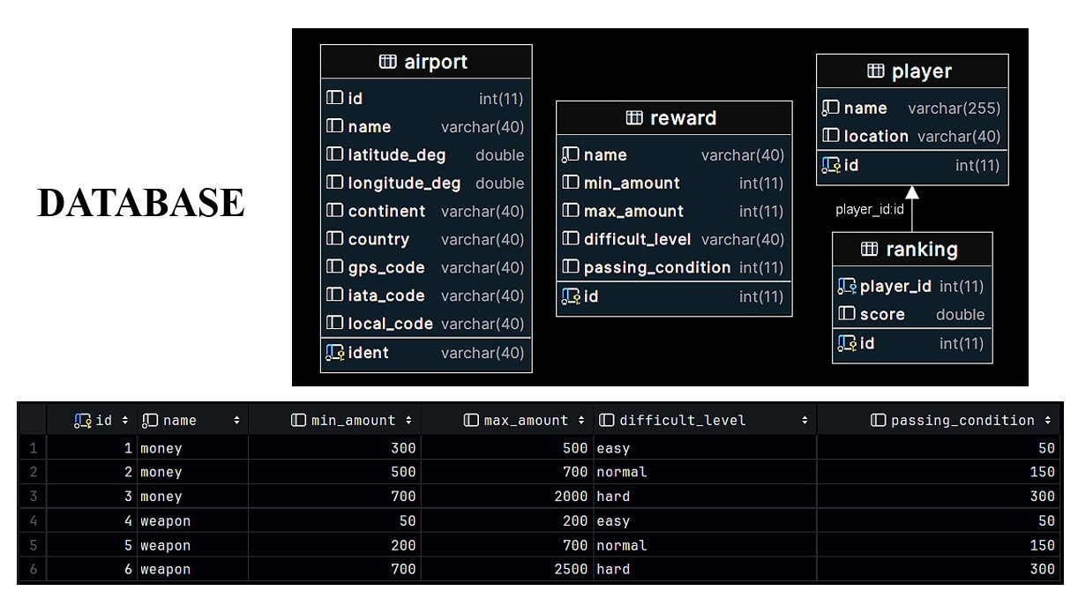
DATABASE

Slide 7
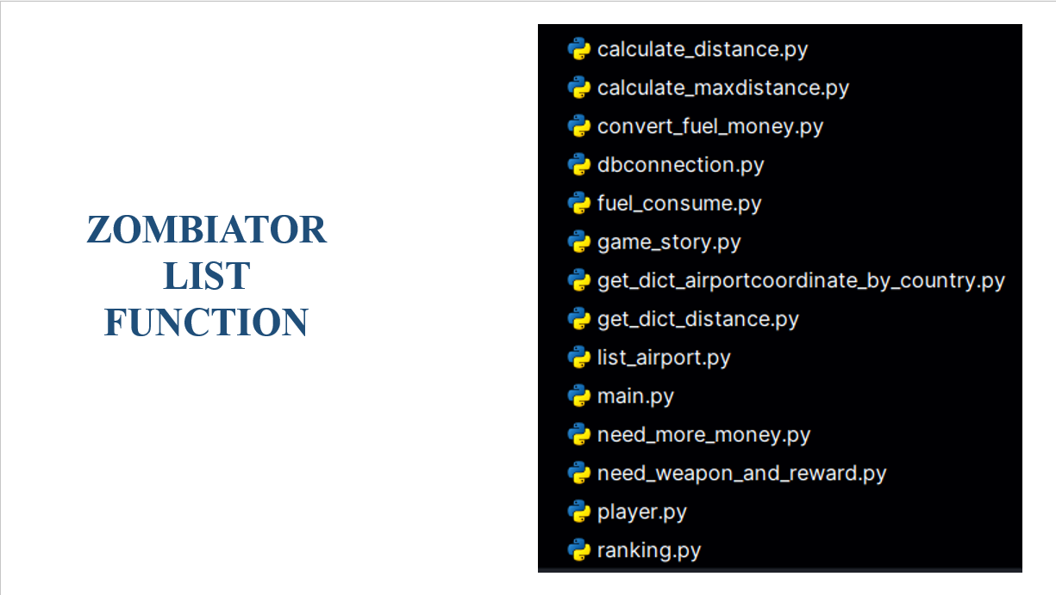
ZOMBIATOR FUNCTION LIST

Slide 8
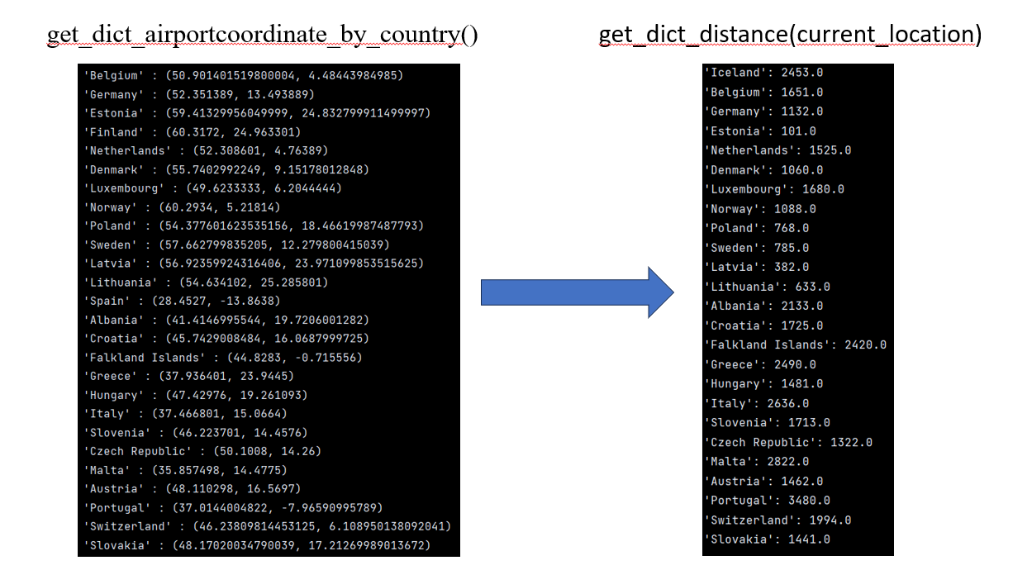
get_dict_airportcoordinate_by_country()
get_dict_distance(current_location)

Slide 9
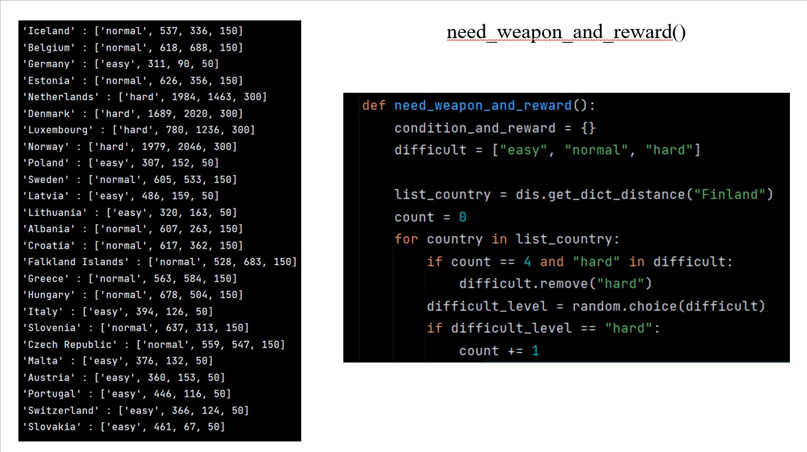
need_weapon_and_reward()

Slide 10
FIX-GAMEPLAY BALANCE BUG
START GAME
weapon = 200
Choose hard country
need_weapon = 300
Mission failed
-50% money
-50% weapon
Get
500 money, 50 fuel, and 200 weapons
from Red Cross Organization
Run out of
money, fuel, weapon

Slide 11
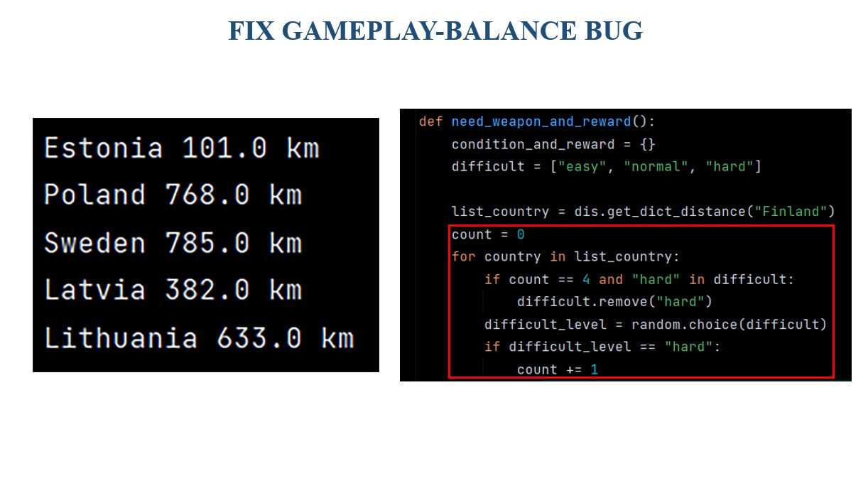
FIX-GAMEPLAY BALANCE BUG

Slide 12

FURTHER DEVELOPMENT IDEAS
1st: After completing the final mission in Madrid, a guest password game will be added where players must enter a 5-digit password to unlock a green power seed.
2nd: Add an option for choosing the electric plane instead of the old plane. The electric plane reduces fuel consumption by half and allows the player to switch from old planes to electric ones.

Slide 13
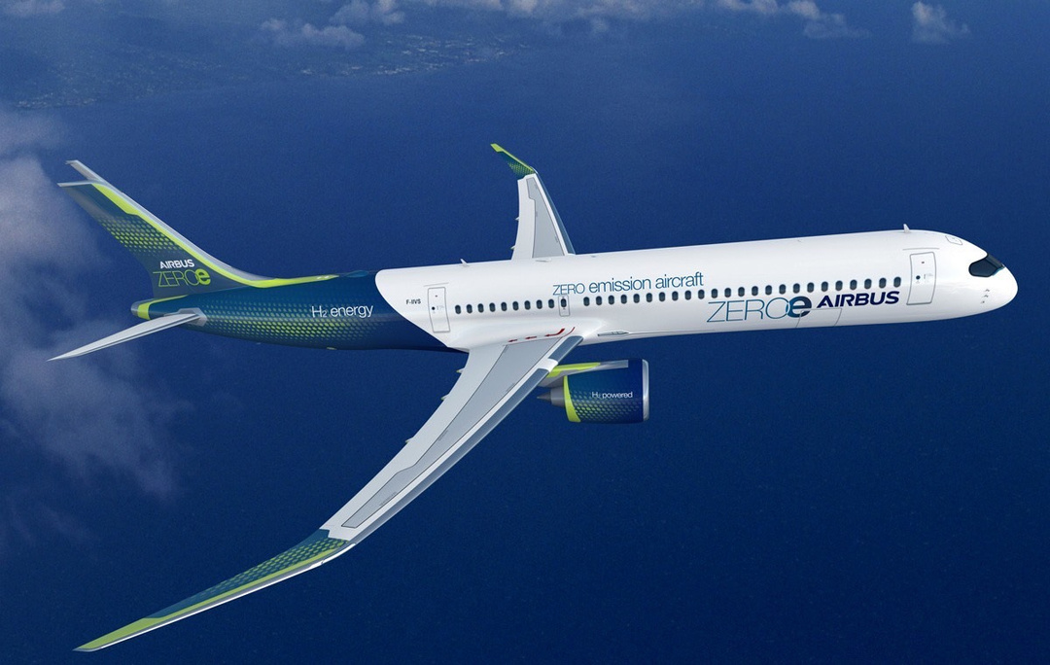
THANK YOU
TO BE CONTINUED

